Slide 1
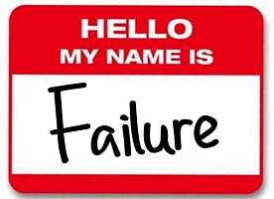








Slide 2
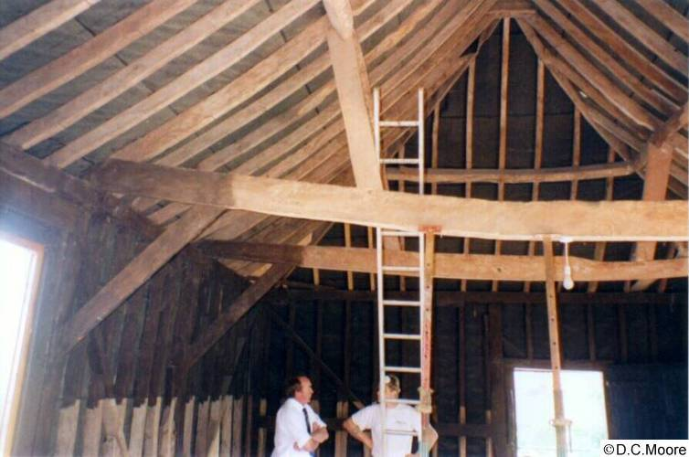
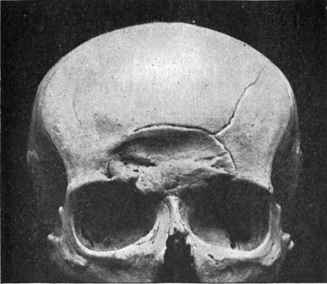

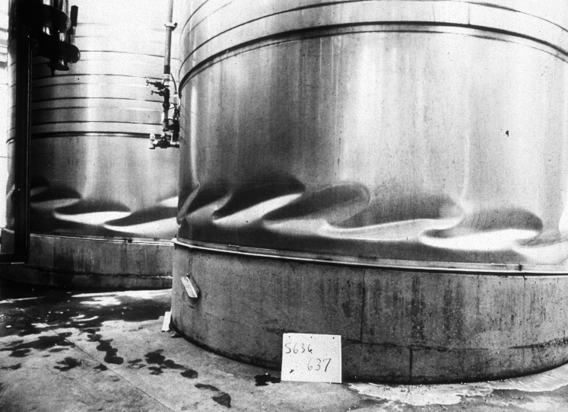
How to Define Failure
Failure: When an object (or design) ceases to perform the function for which it was designed.
Modes of Failure:
Excessive elastic deformation
Fracture
Permanent deformation
Instability

Slide 3
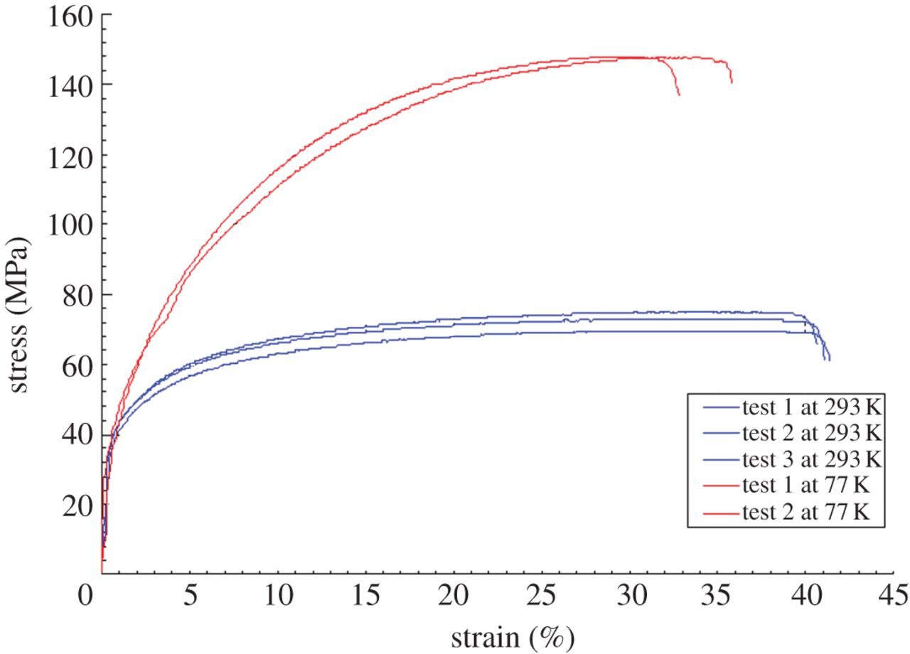
What influences failure?
Aluminum 1050
Mode of failure depends on:
Type of material
Manner of loading
Type
Rate
History of loading
Environment
Temperature
Humidity
Failure criteria must consider these effects
Most failure criteria account for type of material and manner of loading
Modifications to these criteria, may incorporate environment (temperature, humidity) and previous loading (fatigue).

Slide 4
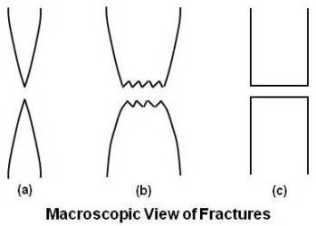
Failure in Brittle vs. Ductile Materials
Mechanism of failure is strongly influenced by material ductility
Ductile: mild steel, aluminum and some of its alloys, copper, magnesium, lead, Teflon
Brittle: concrete, stone, cast iron, glass, ceramics, common metal alloys
Moderate Ductile
Classification
Very Ductile
Brittle
The distinction in ductility may be complicated by temperature
Failure Characteristic
%El or %RA
Large
Medium
Minimal
No failure warning
Warning of Failure

Slide 5
Failure in Brittle vs. Ductile Materials
A large plastic region on the stress-strain curve is a good indicator of a highly ductile material

Slide 6
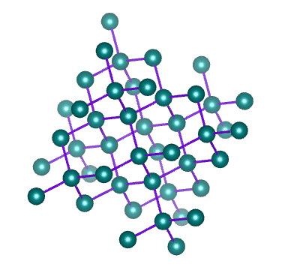
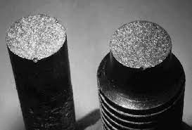
Failure of Brittle Materials: Fracture
Brittle solids tend to be crystalline (covalent network)
Bonds are highly directional
No yielding prior to fracture
Network does not adapt and deform to load
Microcracking forms and grows to create fracture of entire specimen
Failure surface is perpendicular to load direction
Not always true because defects (how and where they are placed) completely dictate fracture pattern
Looking at stress-strain curve, what material property best predicts failure?
σ_{ult}

Slide 7
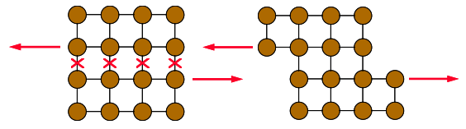
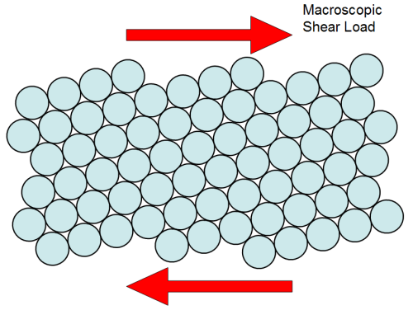
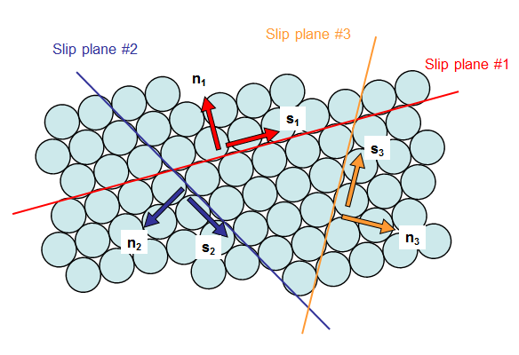
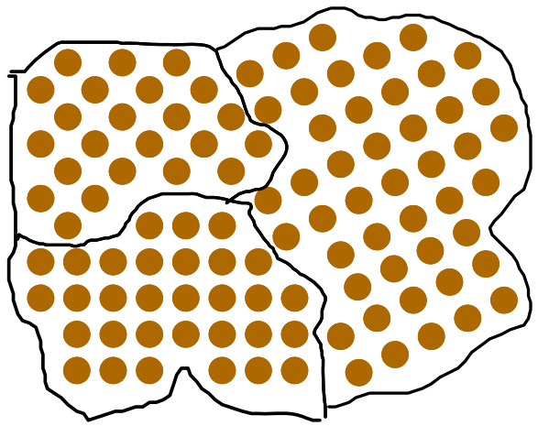
Failure of Ductile Materials: Yielding
Ductile metals have a metallic network
Bonds are non-directional and reform
Relative motion between atoms occurs along slip planes
There are many slips planes and relative motion occurs in each grain
Yield strength is a statistical quantity
Local behavior is different than global behavior
If relative sliding is causing permanent deformation, what material property best predicts failure?
σ_{Y}
Grain boundaries

Slide 8
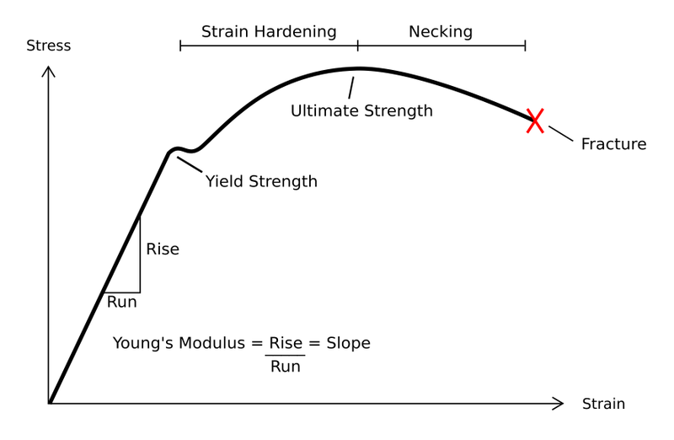
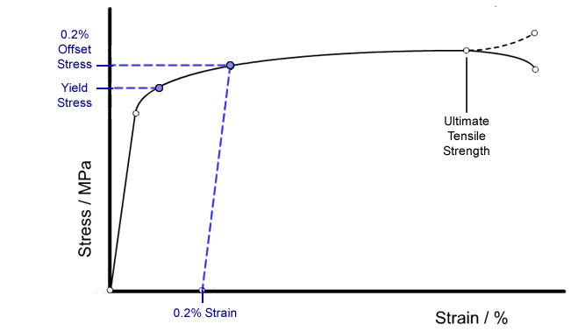
Stress-Strain Curve for Ductile Materials

Slide 9
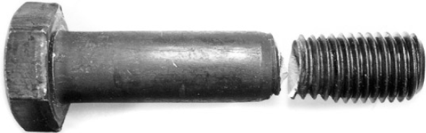
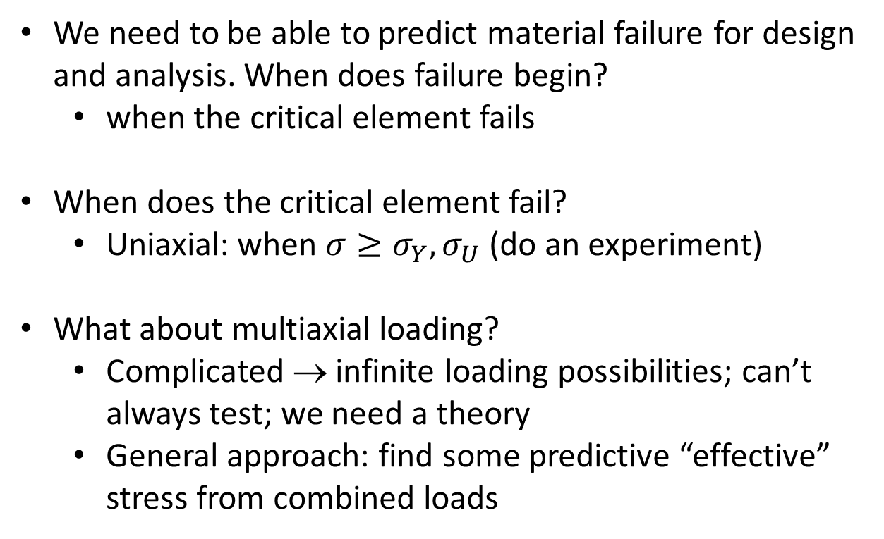
Failure theories
We need to be able to predict material failure for design and analysis. When does failure begin?
when the critical element fails
When does the critical element fail?
Uniaxial: when $σ≥σ_{Y},σ_{U}$ (do an experiment)
What about multiaxial loading?
Complicated → infinite loading possibilities; can’t always test; we need a theory
General approach: find some predictive “effective” stress from combined loads
(www.forgemag.com)
Notes:
Use notes here

Slide 10
Failure Theories
Failure theories are used to:
Determine design parameters
Identify allowable loads
Determine causes of failure after the fact
Failure theories define the onset of failure, so a limit stress or allowable stress for the material is used
Common theories include:
Maximum Principal Stress
Maximum Principal Strain
Coulomb-Mohr’s Theory
Maximum Shear Stress
Strain Energy Density
Distortional Energy Density
Brittle
Based on their names, can you guess which ones perform better for ductile vs brittle materials?
Ductile

Slide 11
Maximum Principal Stress Criterion
Other names: Maximum Normal Stress Criterion; Rankine’s criterion
Definition: Failure begins when maximum principal stress is equal to the tensile (or compressive) ultimate stress, σ_{U} or yield stress, σ_{Y}
Order of principal stress doesn’t matter
$$max\left(\left|σ_{1}\right|,\left|σ_{2}\right|,\left|σ_{3}\right|\right)≥σU,σY$$

Slide 12
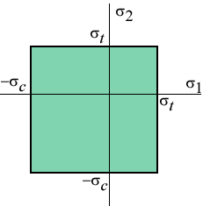
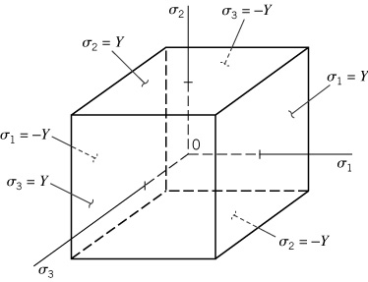
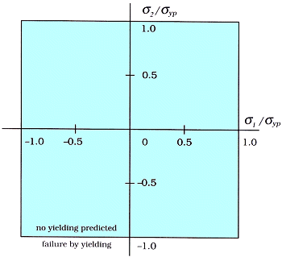
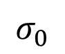
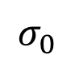
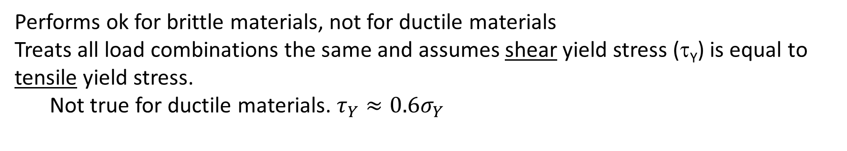
Maximum Principal Stress Criterion
$$σ_{0}$$
$$σ_{0}$$
Performs ok for brittle materials, not for ductile materials
Treats all load combinations the same and assumes shear yield stress (τ_{Y}) is equal to tensile yield stress.
Not true for ductile materials. ${τ_{Y}≈0.6σ}_{Y}$

Slide 13
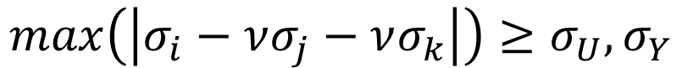
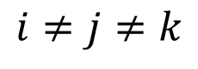
Maximum Principal Strain Criterion
Other names: Maximum Normal Strain Criterion; St Venant’s criterion
Definition: Failure begins when maximum principal strain is equal to the tensile (or compressive) ultimate strain, ε_{U} or yield strain, ε_{Y} = Y/E.*
$$max\left(\left|ε_{1}\right|,\left|ε_{2}\right|,\left|ε_{3}\right|\right)≥ε_{U},ε_{Y}$$
$$max\left(\left|σ_{i}−νσ_{j}−νσ_{k}\right|\right)≥σ_{U},σ_{Y}$$
$$i≠j≠k$$
* ε_{Y} = Y/E assumes yield is at end of linear elastic region

Slide 14
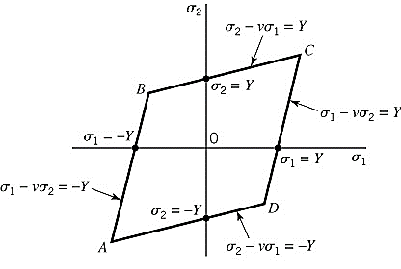
Maximum Principal Strain Criterion
Better performing for brittle materials. Does not predict ductile failure well.

Slide 15
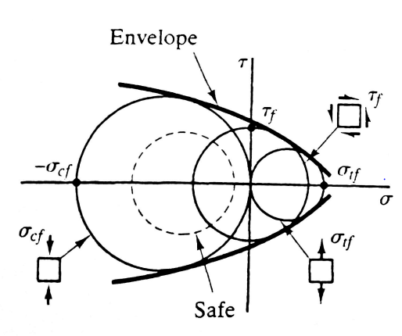
Mohr’s Theory
Designed for brittle materials with different properties in tension and compression, and includes response to shear stress as well as normal stress
Theory: material will fail if Mohr’s Circle associated with applied stresses does not fit within envelope formed by Mohr’s Circles associated with failure in uniaxial compression, uniaxial tension, and pure shear

Slide 16
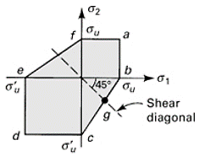
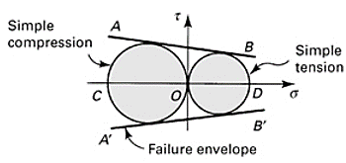
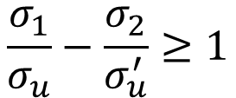
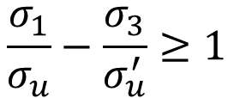
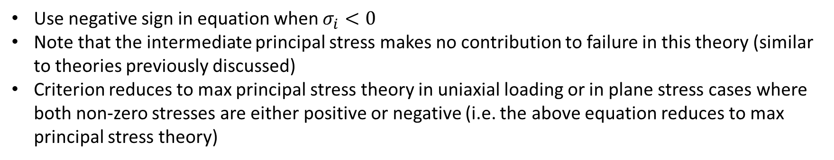
Coulomb-Mohr Theory
Simplifies Mohr theory by building straight-line envelope based on tests to failure in compression and tension only
$$\frac{σ_{1}}{σ_{u}}−\frac{σ_{3}}{σ_{u}^{′}}≥1$$
$$\frac{σ_{1}}{σ_{u}}−\frac{σ_{2}}{σ_{u}^{′}}≥1$$
u = tensile failure criterion
u’ = compression failure criterion
OR
(If 2D)
Use negative sign in equation when $σ_{i}<0$
Note that the intermediate principal stress makes no contribution to failure in this theory (similar to theories previously discussed)
Criterion reduces to max principal stress theory in uniaxial loading or in plane stress cases where both non-zero stresses are either positive or negative (i.e. the above equation reduces to max principal stress theory)

Slide 17
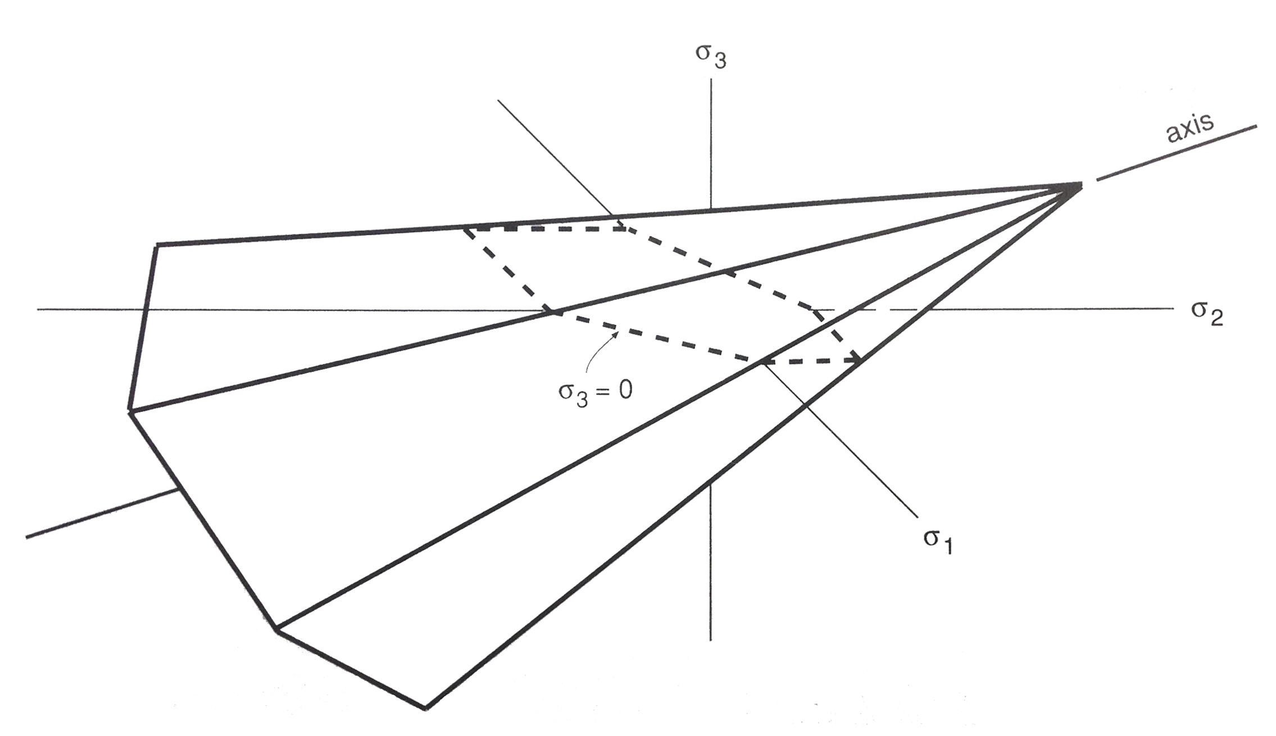
Coulomb-Mohr Theory
* Note that the theory does not perform well for triaxial tension

Slide 18
Note:
Coulomb-Mohr is conservative
Max normal is “liberal”
Dowling

Slide 19
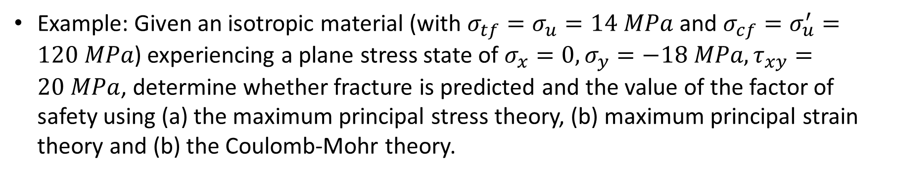
Example 1: Brittle Failure Theory
Example: Given an isotropic material (with $σ_{tf}=σ_{u}=14 MPa$ and $σ_{cf}=σ_{u}^{′}=120 MPa$) experiencing a plane stress state of $σ_{x}=0,σ_{y}=−18 MPa,τ_{xy}=20 MPa$, determine whether fracture is predicted and the value of the factor of safety using (a) the maximum principal stress theory, (b) maximum principal strain theory and (b) the Coulomb-Mohr theory.
Notes:
Cook and Young, p. 55

Slide 20
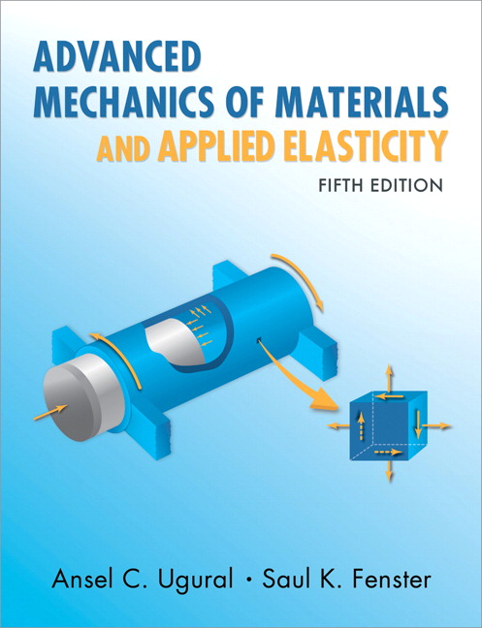
Advanced Mechanics
ANNOUNCE / BUSINESS
HW 3 (due today)
HW 4 (due next Thursday)
Exam 01 (This Thursday)
NEW STUFF
Strain Energy
Energy-based fracture criteria for ductile materials

Slide 21
Failure Theories
Failure theories are used to:
Determine design parameters
Identify allowable loads
Determine causes of failure after the fact
Failure theories define the onset of failure, so a limit stress or allowable stress for the material is used
Common theories include:
Maximum Principal Stress
Maximum Principal Strain
Coulomb-Mohr’s Theory
Maximum Shear Stress
Strain Energy Density
Distortional Energy Density
Brittle
Based on their names, can you guess which ones perform better for ductile vs brittle materials?
Ductile

Slide 22

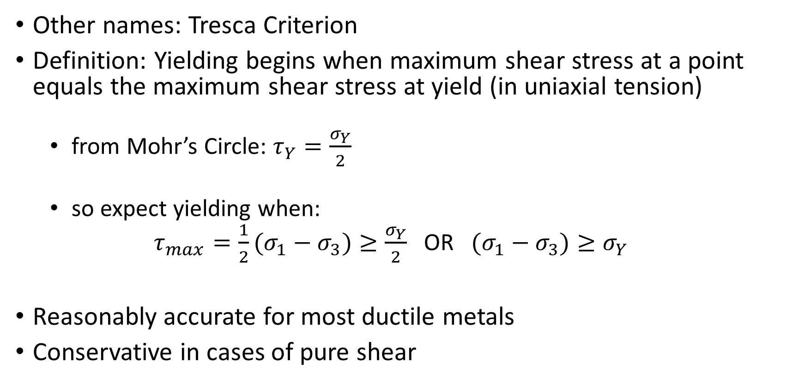
Maximum Shear Stress Criterion
Other names: Tresca Criterion
Definition: Yielding begins when maximum shear stress at a point equals the maximum shear stress at yield (in uniaxial tension)
from Mohr’s Circle: $τ_{Y}=\frac{σ_{Y}}{2}$
so expect yielding when:
$τ_{max}=\frac{1}{2}(σ_{1}−σ_{3})≥\frac{σ_{Y}}{2}$ OR $(σ_{1}−σ_{3})≥σ_{Y}$
Reasonably accurate for most ductile metals
Conservative in cases of pure shear
less than ${τ_{Y}≈0.6σ}_{Y}$

Slide 23
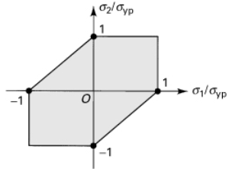
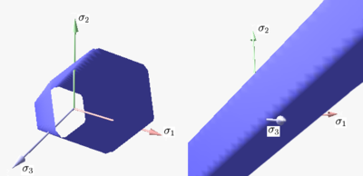
Maximum Shear Stress Criterion
Yield envelope
(plane stress)
pure shear
3D
Wikipedia
Note that criterion predicts no contribution of hydrostatic stress to failure

Slide 24
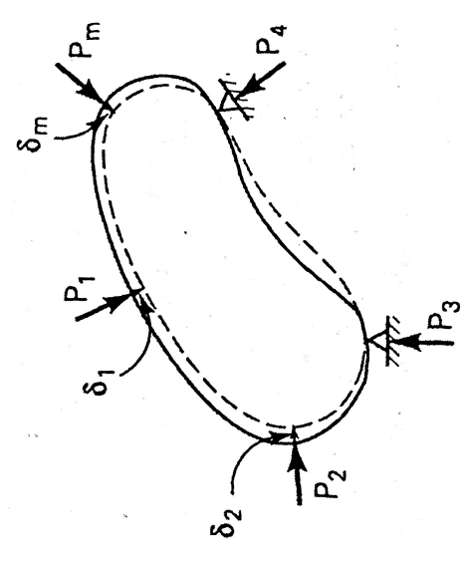
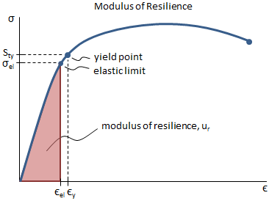
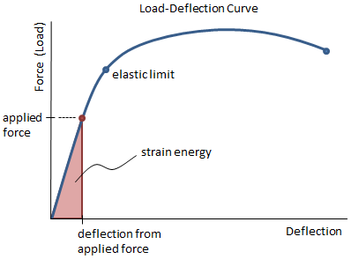
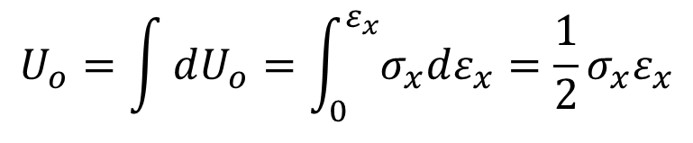
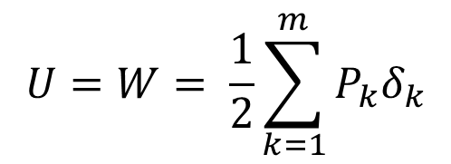
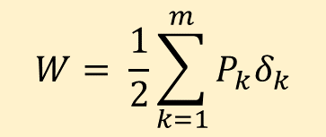
Work-Energy Relationship
Work is performed on a particle by a force if there is a component of that force acting on the particle and parallel to the direction of displacement of the particle.
From our previous lectures, recall:
Work leading to deformation is not lost, but is stored as strain energy in an elastic body
$$W= \frac{1}{2}\sum_{k=1}^{m}{P_{k}δ_{k}}$$
$$U_{o}=\int{dU_{o}}=\int_{0}^{ε_{x}}{σ_{x}dε_{x}}=\frac{1}{2}σ_{x}ε_{x}$$
(U_{o} is strain energy density, or strain energy per unit volume for uniaxial deformation)
$$U=W= \frac{1}{2}\sum_{k=1}^{m}{P_{k}δ_{k}}$$

Slide 25
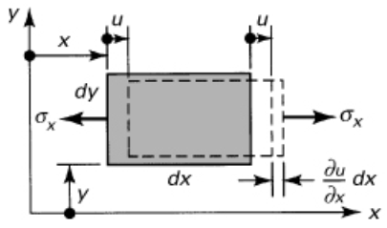
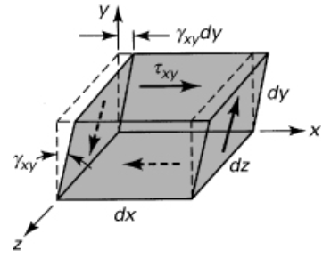
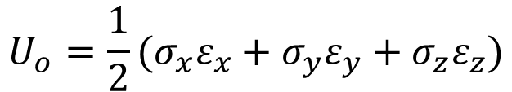
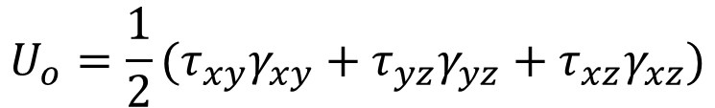
3D Strain Energy Density
3D strain energy density for normal stress/strain:
$$U_{o}={{\frac{1}{2}(σ}_{x}ε}_{x}+{σ_{y}ε}_{y}+{σ_{z}ε}_{z})$$
3D strain energy density for shear stress/strain:
$$U_{o}={{\frac{1}{2}(τ}_{xy}γ}_{xy}+{τ_{yz}γ}_{yz}+{τ_{xz}γ}_{xz})$$
3D total strain energy density:
$$U_{o}={{\frac{1}{2}(σ}_{x}ε}_{x}+{σ_{y}ε}_{y}+{σ_{z}ε}_{z}+{{ τ}_{xy}γ}_{xy}+{τ_{yz}γ}_{yz}+{τ_{xz}γ}_{xz})$$

Slide 26
Strain Energy Density Criterion
Other names: none
Definition: Yielding begins when strain energy density at a point equals the strain energy density at yielding due to uniaxial tension or compression
Assumes isotropic material and proportional limit = elastic limit
$$σ_{1}^{2}+σ_{2}^{2}+σ_{3}^{2}−2ν(σ_{1}σ_{2}+σ_{1}σ_{3}+σ_{2}σ_{3})≥Y^{2}$$

Slide 27
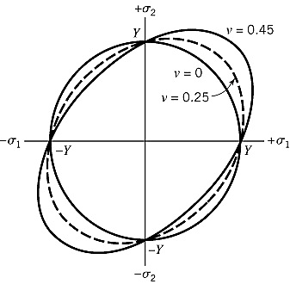
Strain Energy Density Criterion
Elliptical shape depends on Poisson’s ratio. When v = 0, shape is a circle/sphere with radius of Y

Slide 28
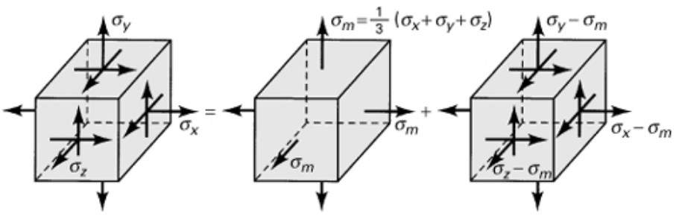
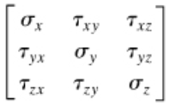


Distortional Energy Density Criterion
Other names: von Mises Criterion, Octahedral Shear Stress Criterion; Maximum Distortional Energy Criterion
Definition: Yielding begins when distortional strain energy density at a point equals the distortional strain energy density at yielding due to uniaxial tension.
=
+
total stress
dilatational stress
(max shear stress is zero!)
deviatoric (or distortional or deviator) stress

Slide 29



Distortional Energy Density Criterion
Strain energy can be broken up into volumetric and deviatoric strain energies (similar to the stress state):
Dilatational (or volumetric) strain energy density
Distortional strain energy density

Slide 30
Example 2: Distortional Strain Energy
An isotropic, prismatic bar is loaded in uniaxial tension. Let $ν=0.25$.
Find $U_{o}$, $U_{ov}$, $U_{od}$

Slide 31


Distortional Energy Density Criterion
Distortional Strain Energy Density:
Converting to principal stress (shear = 0)
$$τ_{oct}=\frac{1}{3}\sqrt{{\left(σ_{1}−σ_{2}\right)}^{2}+{\left(σ_{2}−σ_{3}\right)}^{2}+{\left(σ_{3}−σ_{1}\right)}^{2}}$$
$$\frac{1}{3}\sqrt{{\left(σ_{1}−σ_{2}\right)}^{2}+{\left(σ_{2}−σ_{3}\right)}^{2}+{\left(σ_{3}−σ_{1}\right)}^{2}}≥\frac{\sqrt{2}}{3}σ_{Y}$$
$${\left(σ_{1}−σ_{2}\right)}^{2}+{\left(σ_{2}−σ_{3}\right)}^{2}+{\left(σ_{3}−σ_{1}\right)}^{2}≥2σ_{Y}^{2}$$
${\left(σ_{xx}−σ_{yy}\right)}^{2}+{\left(σ_{yy}−σ_{zz}\right)}^{2}+{\left(σ_{zz}−σ_{xx}\right)}^{2}+6\left(σ_{xy}^{2}+σ_{yz}^{2}+σ_{xz}^{2}\right)$ $≥2σ_{Y}^{2}$

Slide 32


Maximum Distortion Energy Theory
2D failure envelope
3D failure surface
Again, no contribution of hydrostatic stress to failure

Slide 33

Distortional Energy Cont.*
Octahedral shear-stress criterion
Predicts failure by yielding when the octahedral shearing stress at a point achieves a particular value. This value is determined by the relationship between $τ_{oct}$ to $σ_{yp}$ in a simple tension test.
$τ_{oct}=\frac{\sqrt{2}}{3}Y$
Octahedral shearing stress theory enables us to apply the distortion energy while dealing with stress rather than energy
$$τ_{max}=\frac{1}{3}\sqrt{ {\left(σ_{1}−σ_{2}\right)}^{2}+{\left(σ_{2}−σ_{3}\right)}^{2}+{\left(σ_{3}−σ_{1}\right)}^{2}}=\frac{1}{3}\sqrt{2Y^{2}}$$

Slide 34
Empirical Comparison
Note:
Tresca is conservative
Von Mises is accurate
Dowling

Slide 35



Example 3: Ductile Failure Theory
A circular shaft of tensile strength $σ_{y}=350 MPa$is subjected to a combined state of loading defined by bending moment $M=8 kN·m$and torque $T=24 kN·m$. Calculate the required shaft diameter $d$ in order to achieve a factor of safety $n=2$. Apply (a) the maximum shearing stress theory and (b) the maximum distortion energy theory.
Recall:
Max shear stress theory: $(σ_{1}−σ_{3})≥σ_{y}$
Max distortion energy theory:

Slide 36



Anisotropic Material Failure
Note that the failure theories we’ve discussed assume isotropy
Anisotropic material failure is more complex and requires different theory that is outside the scope of this course

Slide 37










Example
A closed thin-wall tube has a mean radius of 40.0 mm and wall thickness of 4.0 mm. It is subjected to an internal pressure of 11.0 MPa. The axis of the tube lies along the z axis. In addition to internal pressure, the tube is subjected to an axial load P=80.0 kN, bending moments Mx = 660Nm and My = 480Nm and torque T = 3.6 kNm. If yielding is impending in the tube, determine the yield stress Y of the material based on the maximum shear-stress criterion of failure.
$$t=4mm$$
$$y$$
$$R=40 mm$$
$$P_{int}=11MPa$$
$$x$$
$$z$$
$$P=80 kN$$
$$M_{y}=480 Nm$$
$$M_{x}=660 Nm$$
$$T=3.6 kNm$$

